Slide 1

Homeostasis

Slide 2
After todays lesson you will be able to:
Provide a definition of homeostasis
Know what homeostasis controls
How the body deals with overheating and overcooling (thermoregulation)

Slide 3
What is it?
Homeostasis is the maintenance of a constant environment in the body.

Slide 4
What does it control?
Four major components of the body that are controlled (by homeostasis) are:
Glucose concentration
Water levels
Gas levels
Body temperature

Slide 5
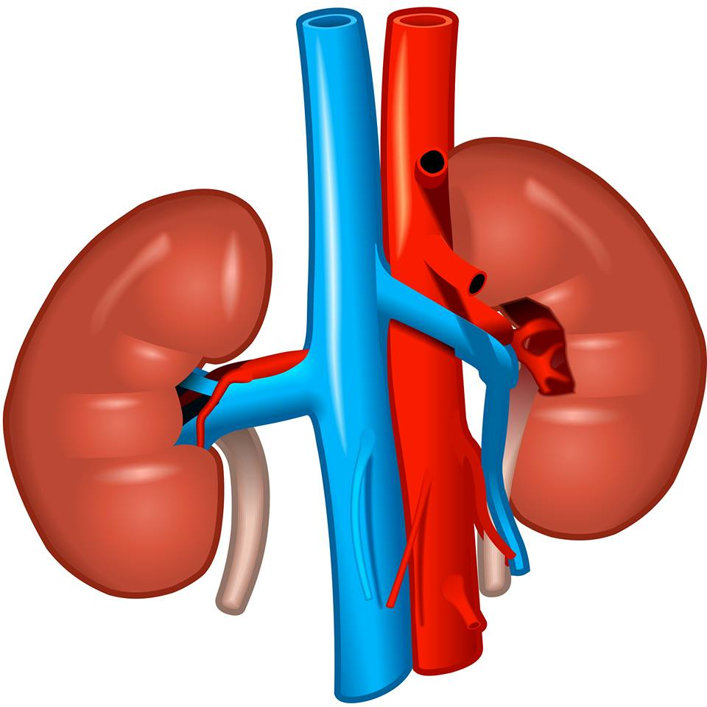
Water level control
Water level control is carried out by the kidneys.
Water level balance is linked with the body’s excretion of urea
Urea is the waste product made when the LIVER breaks down proteins that aren’t needed by the body
Urea contains Nitrogen

Slide 6
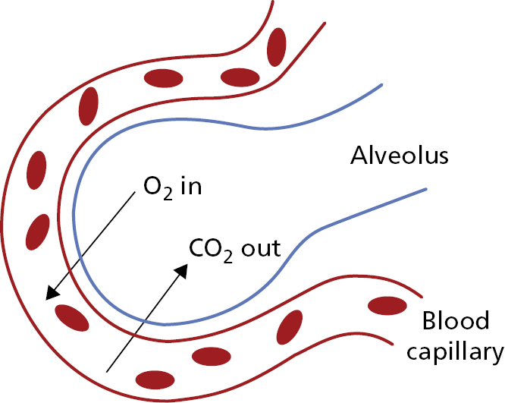
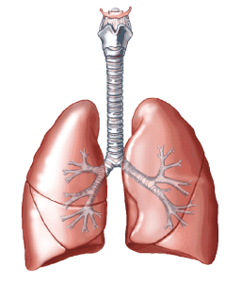
Gas control
Oxygen and carbon dioxide levels are controlled by the lungs.
We breath oxygen into our lungs and it passes into our blood
Carbon dioxide passes from the bloodstream and into our lungs so we can breath it out.

Slide 7
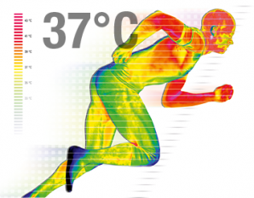
Body temperature control
All mammals maintain a constant body temperature.
Body temperature balance is controlled by the hypothalamus.
Human beings have a constant body temperature of ~37ºC

Slide 8
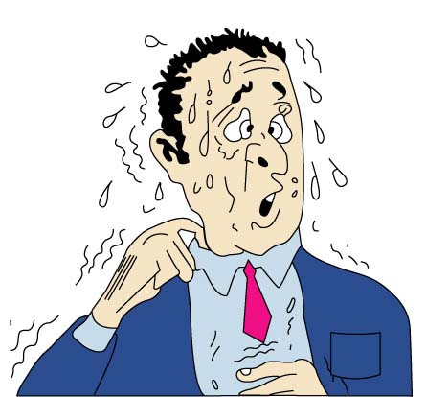
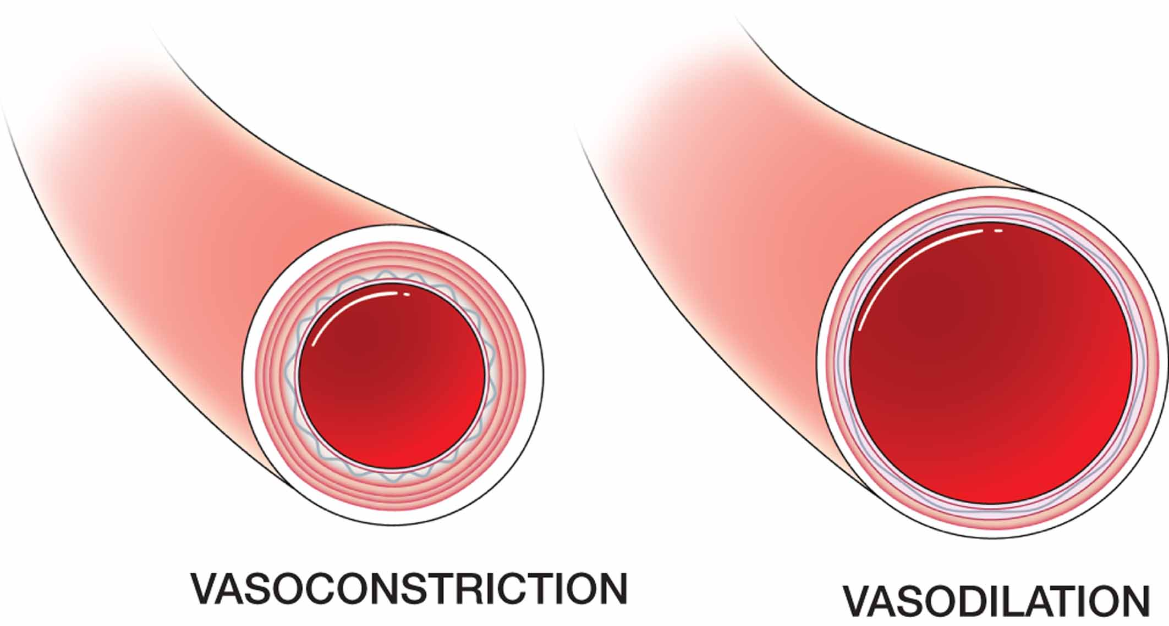
How the body cools down:
Sweating:
When your body is hot, sweat glands are stimulated to release sweat.
As sweat evaporates it removes the heat from your skin
Vasodilation:
Skin capillaries open up (Vasodilation) so blood flows close to the skin

Slide 9
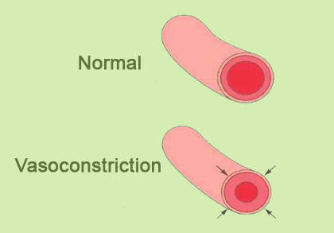
How the body warms up:
Piloerection
“Goosebumps”
Hairs on your skin ‘stand up’, the hairs trap a layer of air next to the skin which is warmed by body heat.
Vasoconstriction
Capillaries become narrower near the skin so blood won’t lose heat as it moves around the body.

Slide 10
Feedback loops
Stimulus
Receptor
Control Center
Effector
Internal Balance

Slide 11
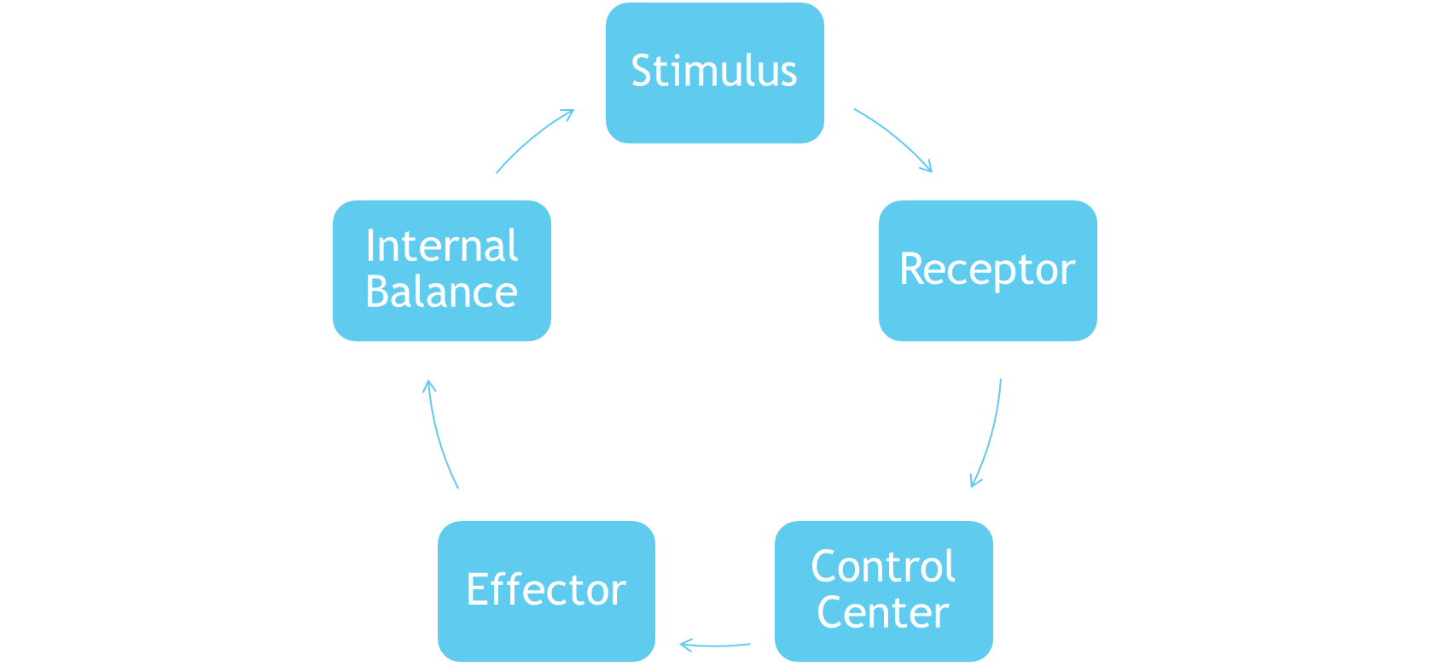
Feedback Loop with Body Temperature
Stimulus
Skin
Brain
Sweating Vasodilation
Internal Balance
Stimulus
Skin
Brain
Goosebumps
Vasoconstriction
Internal Balance
HOT
COLD

Slide 12
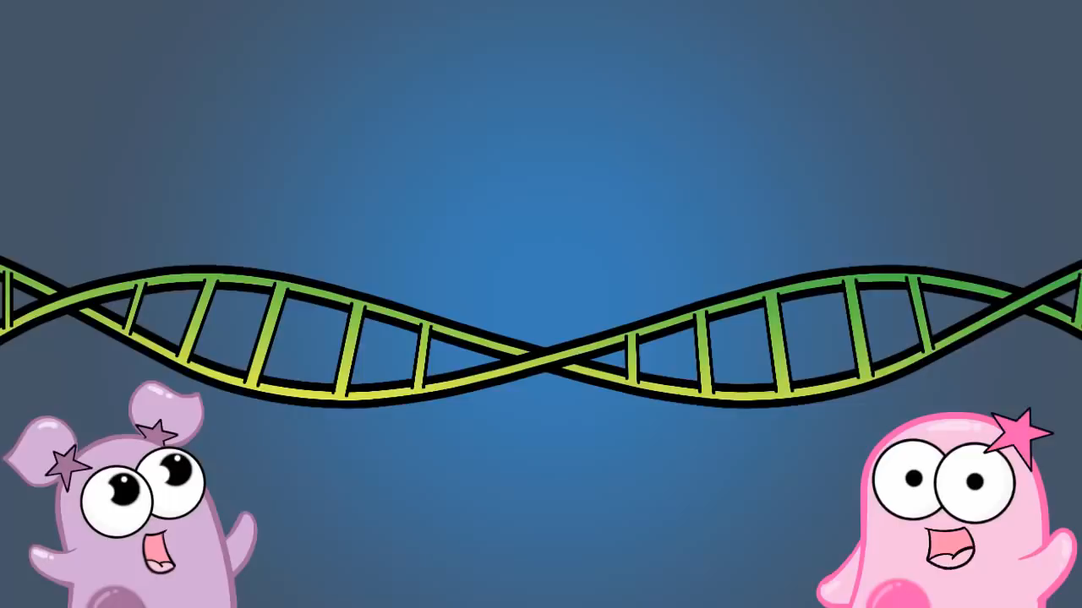

Slide 13
Both Clips located in file and embedded.
https://www.youtube.com/watch?v=quQr6X1Q58I
Fuse School Homeostasis 2.5mins
https://www.youtube.com/watch?v=Iz0Q9nTZCw4
Amoeba sisters homeostasis positive and negative feedback

